Slide 1
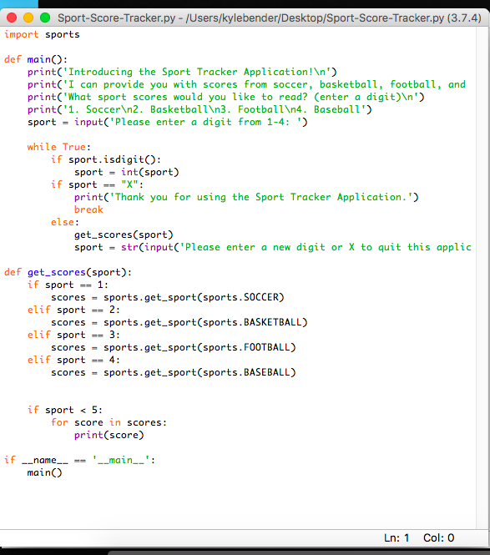
Sport score tracker application
Member(s): Kyle Bender
Concept: Receive scores from basketball, baseball, soccer, and football games of the given day.

